Slide 1
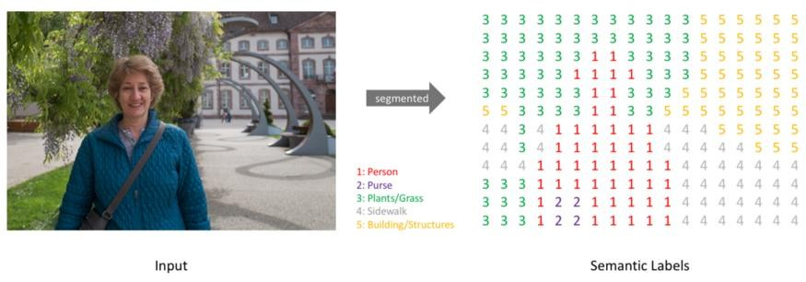
Some models of semantic Segmentation:
Pixel-by-Pixel Classification
Semantic segmentation understands what is on the picture and locates it precisely (every pixel)

Slide 2
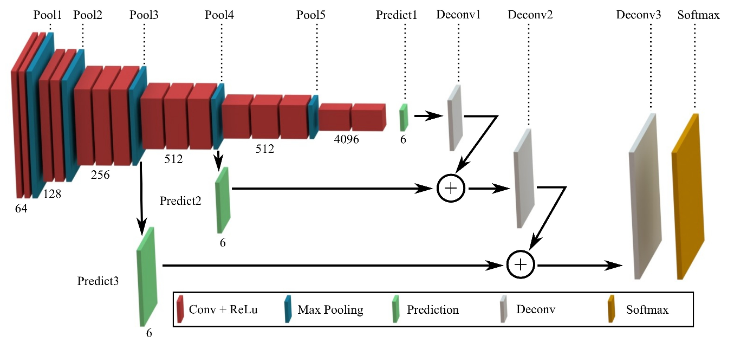
FCN: Fully connected network
FCN = one of the first major CNN model for semantic segmentation – important foundation
Replaces classical classification layers with convolutional layers
Produces a pixel by pixel prediction map
Input: Image --------> Output: segmentation mask

Slide 3
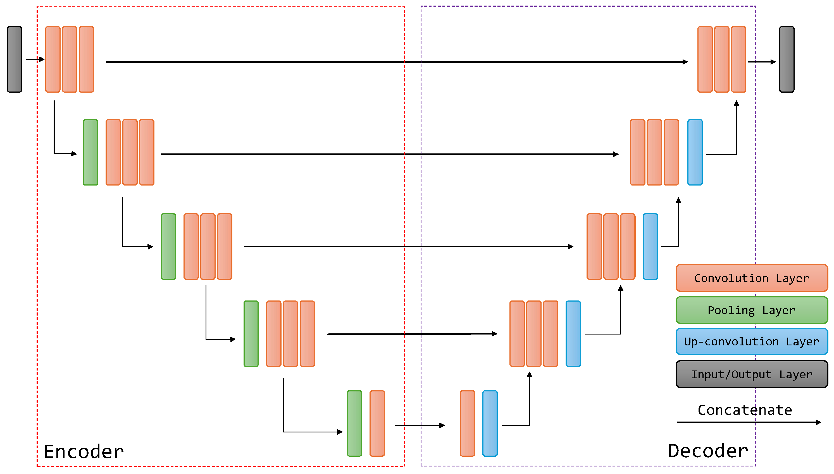
U-Net
U-Net = encoder + decoder
Encoder: extracts important features (reduces image to extract context)
Decoder: reconstructs the segmentation mask
Skip connections: recover lost details
Very useful in medical imaging

Slide 4
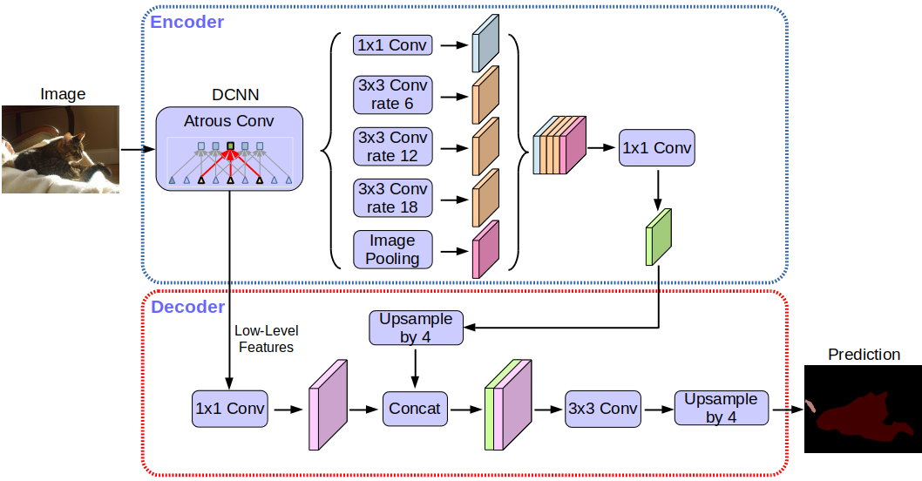
DeepLab
DeepLab: better management of context and boundaries
Uses dilated convolutions (atrous convolutions)
Allows the model to see a larger area without reducing the resolution too much
Uses ASPP to analyze the image at different scales
The deeper is the network the smaller the feature map becomes. Dilated convolutions solve this.
ASPP allows multi-scale analysis to deal with both small or big objects
Downside: Require more data and calculus

Slide 5
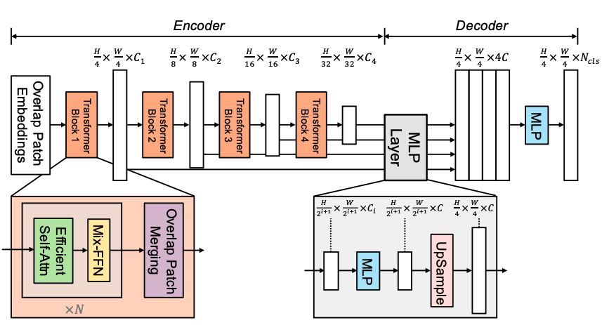
SegFormer: a recent model
Segformer = Transformer-based segmentation model
Uses a transformer encoder
Captures global relationships in the image more effectively
Uses a simple MLP decoder
Represents modern evolution after CNN-based models
Previous models were CNN-based. Segformer uses a transformer which can link pixels at bigger distances than a classical CNN.

Slide 6
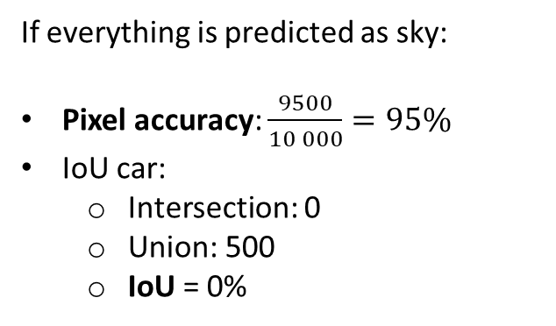
How to evaluate a segmentation model
Metrics used:
Pixel accuracy: percentage of correctly classified pixels
IoU (Intersection over Union): comparison between predicted and real area
mIoU: average IoU across all classes
Pixel accuracy is simpled but can be misleading: a picture with a big sky can have a good accuracy but segment small objects badly
9500 pixels of sky
500 pixels car
If everything is predicted as sky:
Pixel accuracy: $\frac{9500}{10 000}=95\%$
IoU car:
Intersection: 0
Union: 500
IoU = 0%

